Slide 1
The Nuts and Bolts Of ExComm

Slide 2
Introductions
What’s your name?
What’s your Local Group?
Why did you join Mensa?
What did you expect?
How are we doing against those expectations?

Slide 3
Program
LocSec Tradecraft
Follow The Money
Lunch!
Recruit And Retain
PR Hints and Tips
Exploiting the Internet
Volunteer Engagement

Slide 4
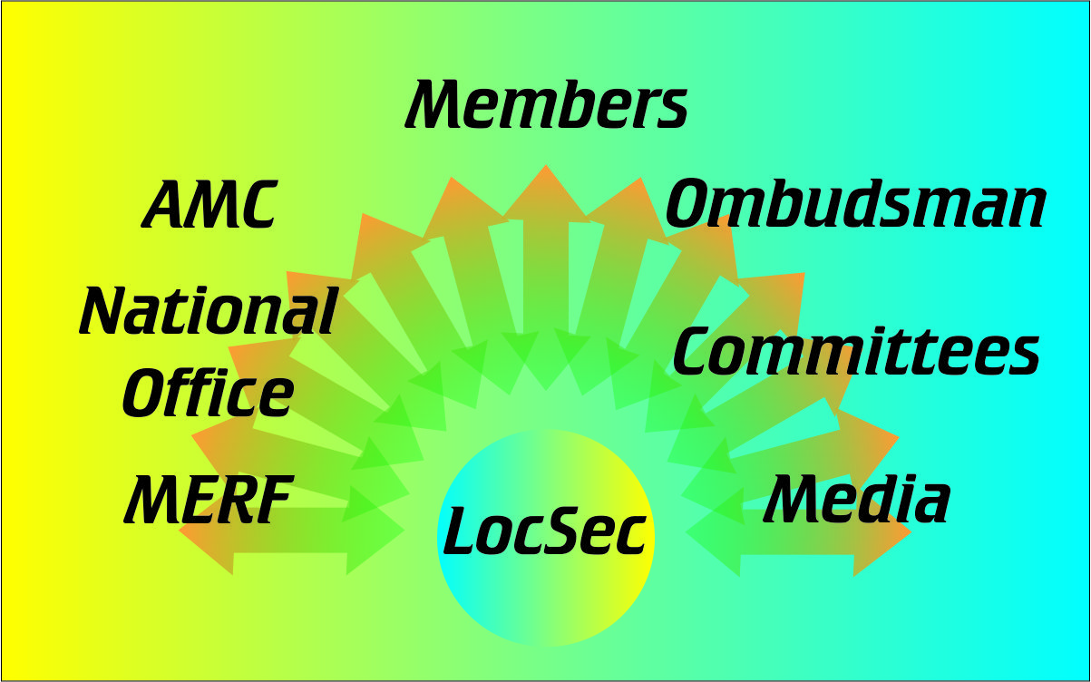
LocSec-ing, from 30,000 feet

Slide 5
Who are your members?
and what do they want from Mensa?
Top choice – intellectual stimulation
Second choice – fun
Demographic considerations
All generations, including YMs
Extroverts and introverts
Educational level
Geography

Slide 6
AMC? What’s that?
National voice of American Mensa Ltd
Committee of Elected officers, RVCs
Hires the Executive Director
Sets policy for the ED
Fiduciaries for AML, all uninc’ed LGs
Sponsors national events
“Sets the rules” for LGs

Slide 7
National Office
AML’s operational arm
Maintains membership records
Collects, distributes dues
Publishes the Bulletin
Supports IT functions for NO and LGs
Implements national PR campaigns
Manages licensed partnerships

Slide 8
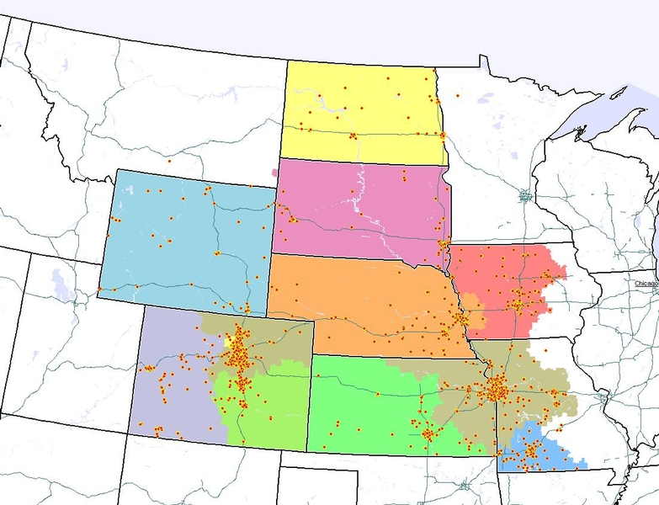
What’s a Region?
A geographical portion of the US
An administrative unit within AML
Through the RVC, a vote on the AMC
Some sponsor Regional Gatherings
Region 7 is an extreme
Largest land area, fewest people
Most challenged for face-to-face contacts

Slide 9
MERF (aka “The Foundation”)
AML’s charitable arm
AML is 501(c)(4), not tax-deductible
MERF is 501(c)(3)
Supports scholarship programs, etc.
Supported by CultureQuest® entry fees, donations, activities at the AG
www.youtube.com/watch?v=2kl3uqK_cQM

Slide 10
Ombudsman structure
Arms-length to AMC, LG ExComms
An attempt to address “the difficult member problem”
Need an expert in mediating disputes
Appointed locally, vetted nationally
You don’t need an Ombudsman until you need an Ombudsman

Slide 11
Media (a.k.a, PR)
LocSec is the designated speaker
Brag when you can
Press, TV will come to you when something newsworthy (i.e., bad) happens. Try to get the right info before they do.
In case of crisis, contact National (817.607.0060 x5512), refer press to them
Social media is a whole other thing

Slide 12
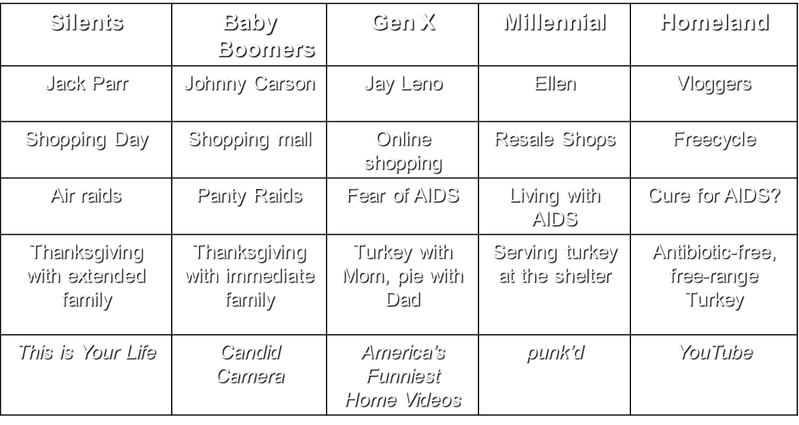
The Generation Thing…

Slide 13
LocSec-ing, from 300 feet up

Slide 14
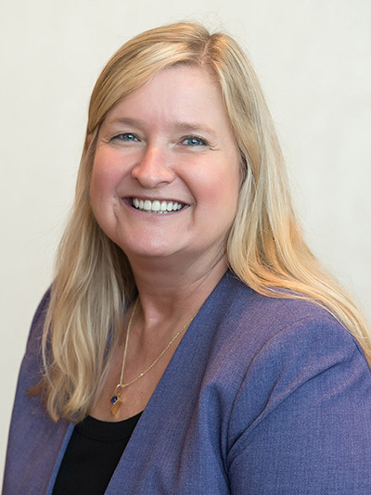
AMC
Guided by “the Strategic Plan”
Membership (value, diversity, growth)
Governance (clear and open communication)
Leadership development (grow volunteers)
Public awareness (branding outreach)
Finance (budget for current, future needs)
Used to assess every action & report
Online at Lead→Strategic Planning
RVC: 2-way communication channel
LaRae Bakerink
Notes:
Handout – 2016-2020 Strategic Plan

Slide 15
AML Governing Documents
Bylaws of International Mensa
Constitution and Bylaws of AML
Actions Still In Effect (a.k.a. ASIEs)
LG Bylaws and operations must observe relevant portions of these (See “Minimum Standard Bylaws”)
Online under Lead→Policy Documents

Slide 16
AMC Committees
Execute most of the operational work
Currently 20, can vary
Listed online under AMC→Committees
AG 2018
Bylaws
Election
etc…
Committee service (AG, Mind Games, etc.) is a good entrée to national-level action.
Gifted Youth
SIG
Testing Team

Slide 17
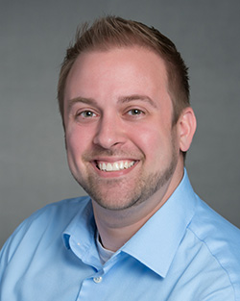
National Office
Executive Director: Trevor Mitchell
executvedirector@americanmensa.org
“CEO” of our $4M non-profit
Responsible for all back-office ops
Responsible for keeping to budget
Hires all staff and consultants
Answers to the AMC’s policies
Trevor Mitchell

Slide 18
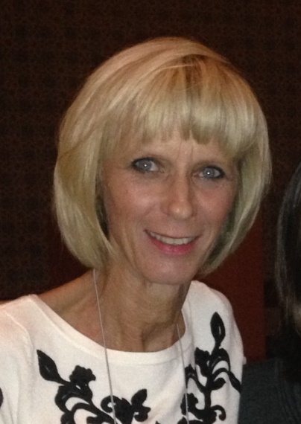
National Office LG support
Online: us.mensa.org→Lead →Local Group Resources
Primary contact: Becky Folger, Local Group Services Manager
localgroups@americanmensa.org
(817) 607-0060 ext. 5524
“Who do I talk to about?” questions
(RVC helps with “How do I?” questions)
Becky Folger

Slide 19
Get Familiar with…
Notes:
Handout – How to email, upload NLs

Slide 20
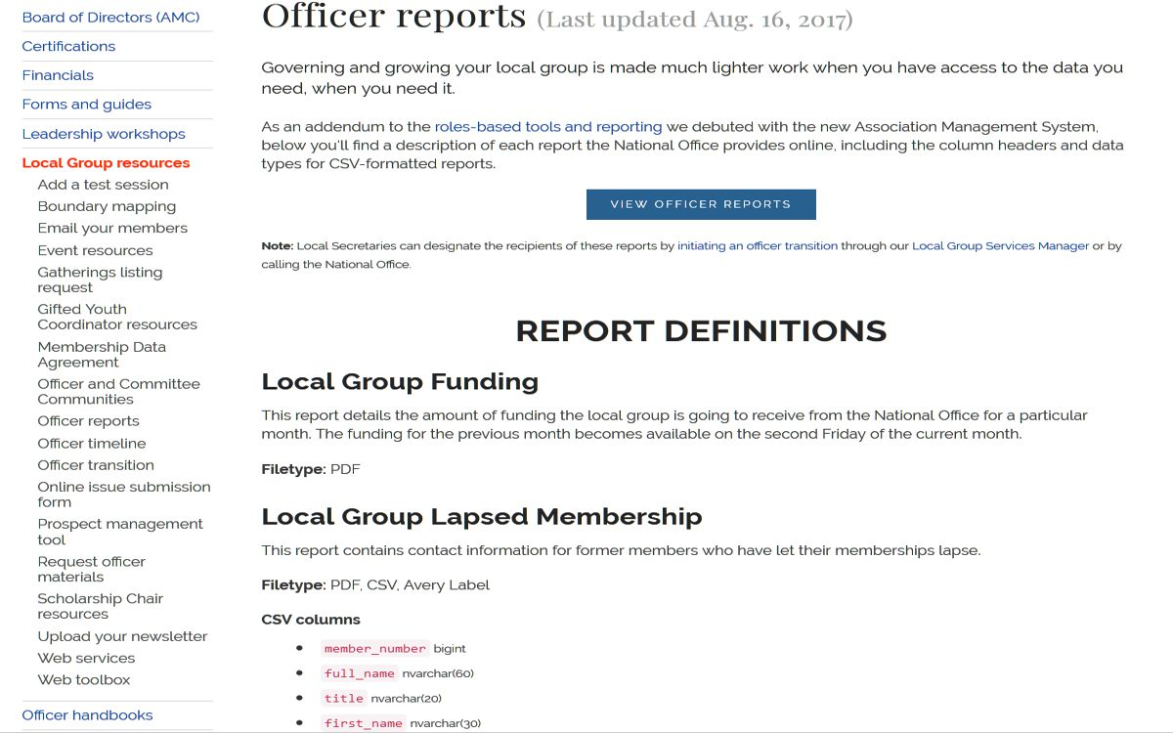
Notes:
Handout –print mailing labels,

Slide 21
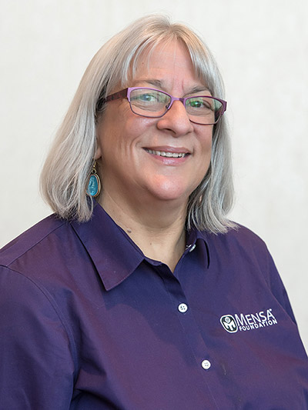
The Foundation
Scholarships, scholarships, scholarships
But wait, there’s more…
A big part of our brand outreach
High-visibility award programs for teachers, researchers, creatives
A new push for big-$$ donors
Online at www.mensafoundation.org
Marie Mayer
Notes:
Jane’s pitch

Slide 22
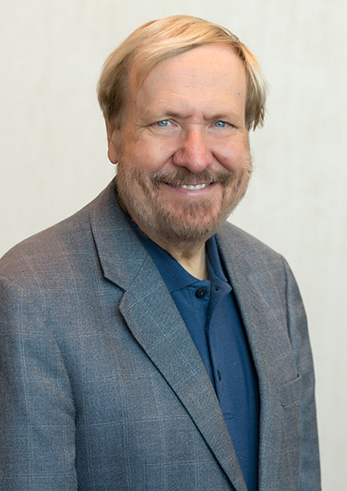
Grievance policies
“Is it a Mensa problem, or is it merely a dispute between two individuals who happen to be Mensans?”
Our established processes for addressing disputes are listed online at Lead → PolicyDocuments → Grievance Policies
If a member fails to exhaust our policies before going to court or other venues, that’s “Conduct Inimical to Mensa” and grounds for expulsion.
Bud Kluek
Notes:
Handout – Seilor’s “Grievance Procedure” presentation

Slide 23
LocSec-ing at ground level

Slide 24
Job description
Head cheerleader and fun-maker
Get other people to do things, maybe help
Lead the applause for their success
Recruiter of future leaders
Strategist and inspirer
Face of Mensa
Promoting our external reputation
Setting the tone within the group
ExComm chair
Point of contact with NO, RVC

Slide 25
If you’re doing it all,
you’re doing it wrong
If you do all the jobs “well enough,” they’ll let you keep doing them
Your real job is to get acquainted with everybody
What you need to find out
Who would have fun where?
Notes:
Handout – Demeter’s “Succession Planning” presentation

Slide 26
Succession Planning
What positions are vacant now?
What vacancies will happen soon?
Who would have fun where?
Vacancy categories
Leaders
Followers
Set expectations
Meaningful job descriptions, with time requirements
Craftsmen
Service providers
Notes:
Handout – Demeter’s “Succession Planning” presentation

Slide 27
Strategy – Keep these in mind
Membership
Increase member value
Encourage diversity within the membership
Encourage consistent baseline member experiences
Encourage and recognize member contributions
Governance
Promote understanding about roles, responsibilities, and relationships

Slide 28
Local Group Committees/SIGs
ExComm as specified by local ByLaws
Other comms created as you see fit
To address a function (e.g., newsletter, hospitality, Young Mensan activities)
To produce/sponsor an event
Committee versus SIG
The Ron Olsen Rule: “Give everybody something to do.”

Slide 29
Setting the Pitch and Tone
Keep an “elevator speech” ready
Mensa’s three purposes (esp. #3)
What we do to support them
You can crib from
www.us.mensa.org/learn/about/
Keep those same thoughts in mind as you interact with your members

Slide 30
Fast and Effective Meetings
Fast meetings are fun meetings
Chair’s job is to point, not to talk
Firm and fair→ respect → effectiveness
You won’t need Roberts’ Rules until you need Roberts’ Rules
Mind the 5 P’s and you’ll be fine

Slide 31
The Five P’s
Planning
Know the Bylaws, gather/filter the agenda
Pre-notification
Send out the agenda 2 weeks in advance
Preparation
Prep the room, have scribe in place, silence phones
Process
Chair is the ref, not a debater. Keep it focused & moving.
Putting it on the record
Minutes: Terse or Verbose?
Notes:
Handout – “Fast and Effective Business Meetings” extract

Slide 32
LG Governing Documents
Order of precedence
AML Constitution, Bylaws, ASIEs
Local Group Charter
Minimum Standard Bylaws
Local Bylaws (could be Model Bylaws)
Local ExComm actions (ASIEs or SOs)
Your Bylaws should explicitly enable remote participation by electronic means
us.mensa.org/lead/policydocuments/

Slide 33
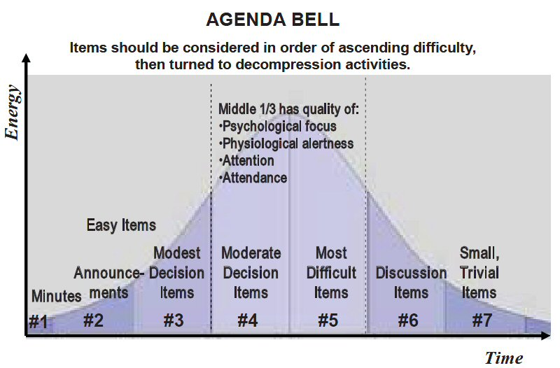
Structuring the agenda

Slide 34
Structuring the Agenda
Traditional
Call to order
Approve Minutes
Officer reports
Committee reports
Old business
New business
Adjourn
Event-driven
Call to order
Approve Minutes
Treasurer’s report
Items for discussion
Annual picnic
Scholarship program
Other officer reports
Adjourn

Slide 35
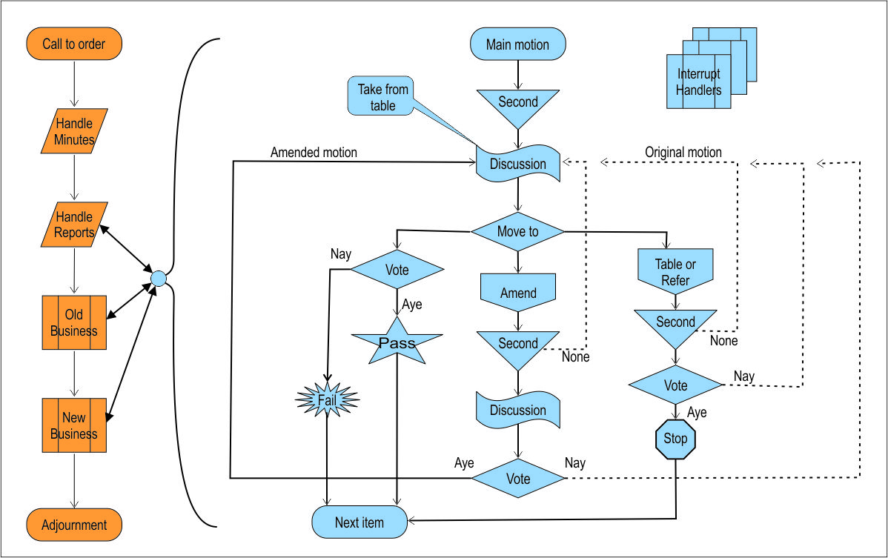
Robert’s Process
Notes:
Handout – Slaughter’s “Parliamentary Motions Guide”

